Slide 1
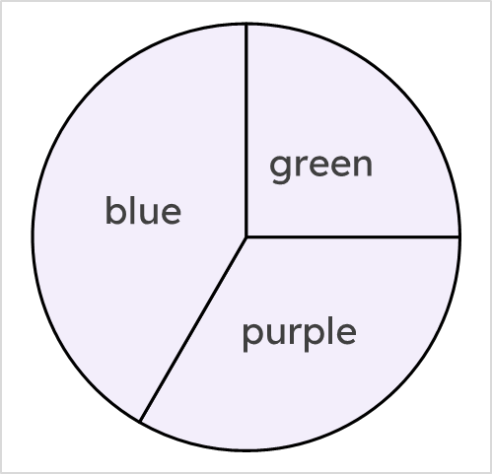


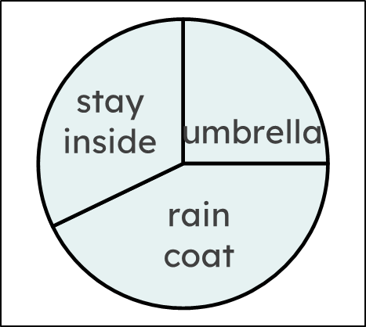
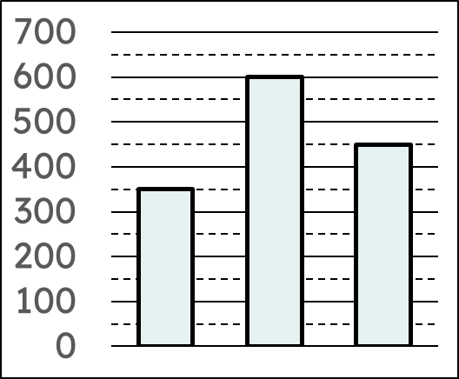
Comparing statistical representations
Task A: Comparing pie charts and bar charts
1) Tick the statements that are easy to determine from a quick glance at the pie chart.
a
Data was collected on a total of 288 students
b
A quarter of students voted green
c
120 students voted blue
d
The modal colour was blue
Pie chart showing students’ favourite colours.
e
Under half of students voted purple
2) Both charts show “methods of staying dry”.
Answer each question in either the “pie chart” or “bar chart” column to show which chart you used to find the answer.
u
rc
si
question | pie chart | bar chart
a) What was the modal method of staying dry? | raincoat | raincoat
b) Which method of staying dry did 25% of people choose? | umbrella
c) True or false: more than 50% of people voted raincoat | false
d) How many more people voted for raincoat than umbrella? |  | 250
e) How many people were asked in total? |  | 1400

Slide 2
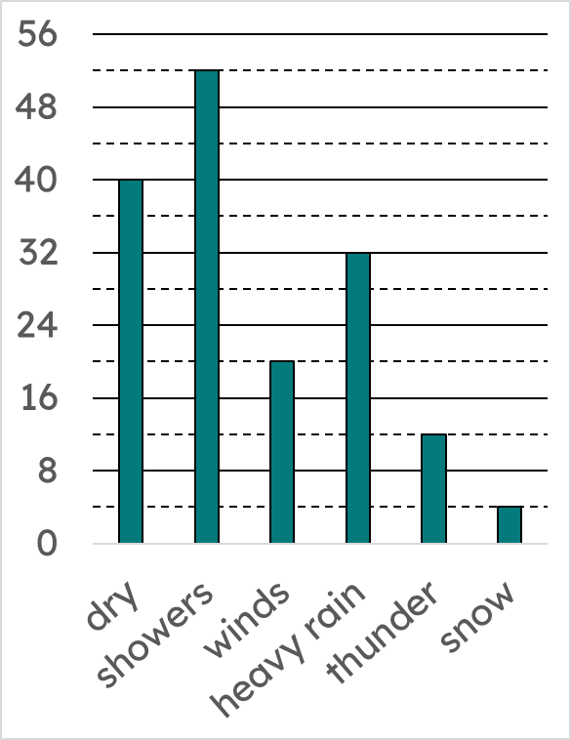
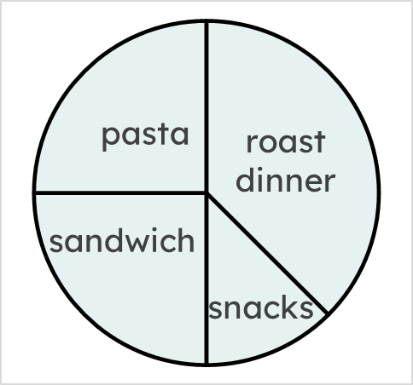
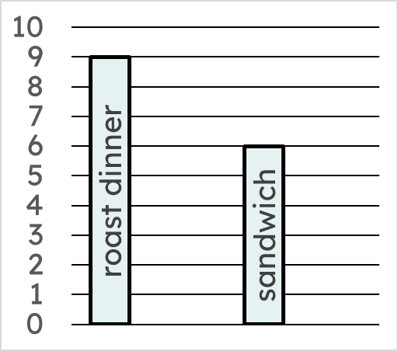
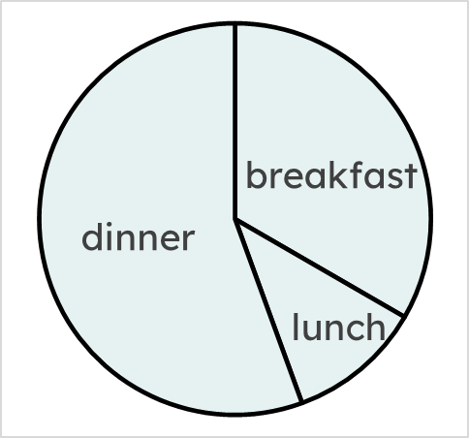
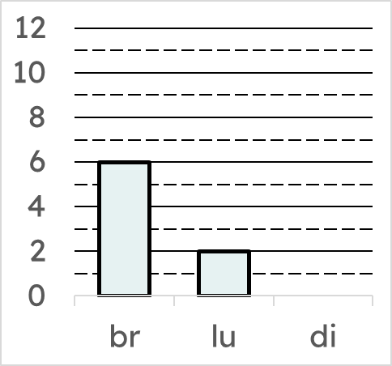
Comparing statistical representations
3) How easy are these questions to answer from the bar chart? Write Q for ‘from a quick glance’, S for ‘with a single calculation’, or M for ‘with many calculations’.
If possible, answer each question.
question | how easy to answer? | answer
a) How many days were dry? | Q | 40
b) What percentage of days had heavy rain? | M | 20%
c) How many more days was it windy than snowy? | S | 16
d) What weather condition occurred 25% of the time? | M | dry
Task B: Matching information between pie and bar charts
1) Both the pie chart and bar chart show the same information about students’ favourite meals.
The angles on the pie chart have been measured.
200°
120°
40°
a) Using information from the pie chart, how many times more people voted for dinner than lunch?
five times more people voted dinner (200°) than lunch (40°)
b) Hence, draw the bar on the bar chart that represents the number of people who voted for dinner.
2) Both the pie chart and bar chart show the same information about lunchtime meals students had one day at school.
90°
135°
90°
45°
pasta
a) Using information from the pie chart, draw the bar on the bar chart that represents the number of students who had pasta for lunch.
snacks
b) Use a protractor to measure the angles in the pie chart.
c) Hence, draw the bar on the bar chart that represents the number of students who had snacks for lunch.

Slide 3
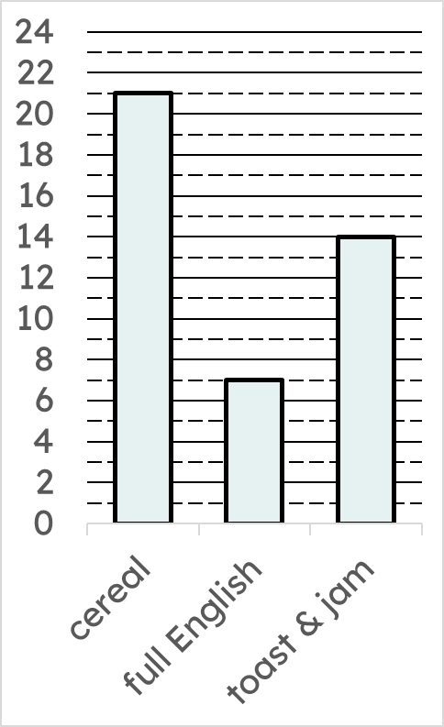
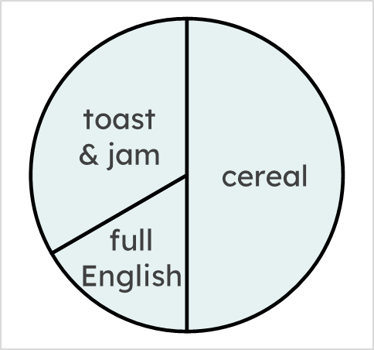
Comparing statistical representations
3) Both the partially drawn pie chart and bar chart show the same information about breakfast meals students had one day at school.
120°
180°
By using the bar chart, complete and label the pie chart.
60°

